Slide 1


Slide 2
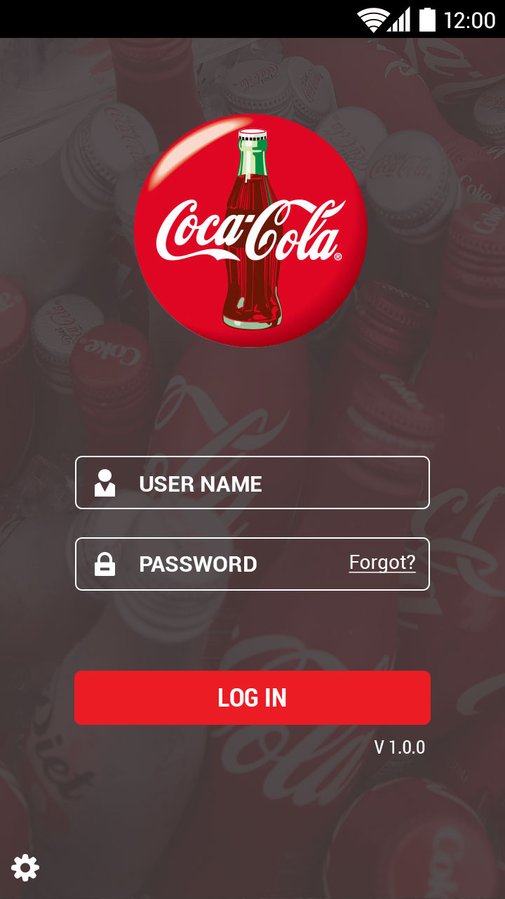
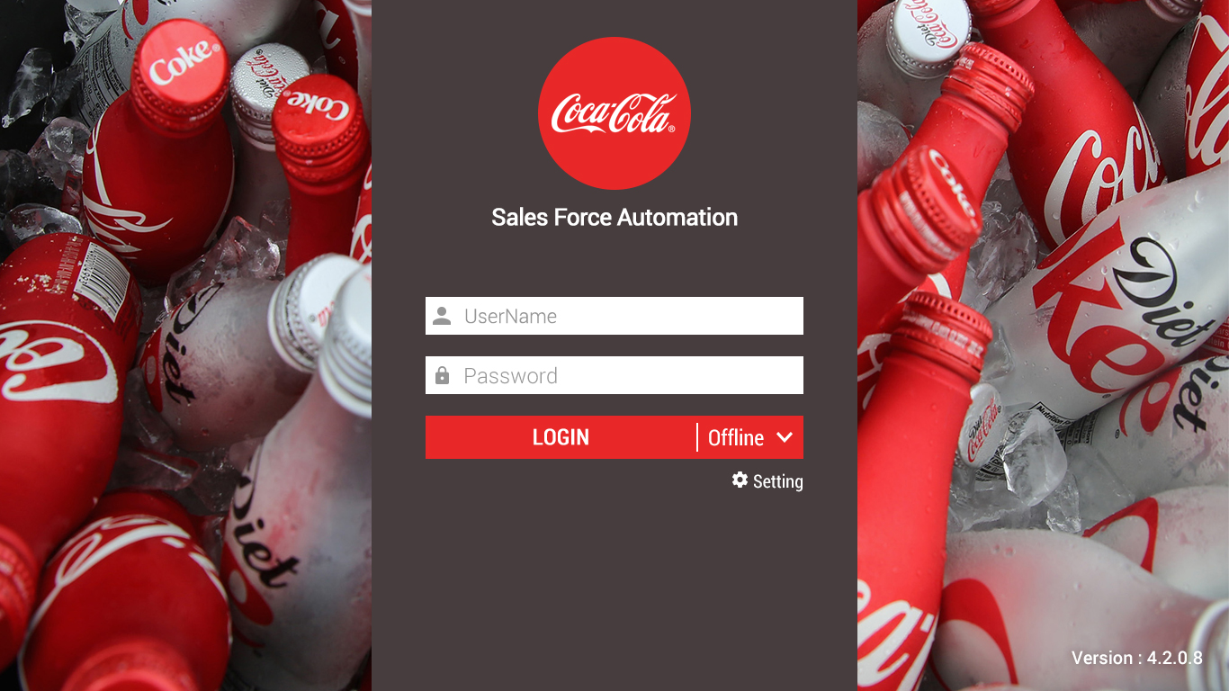
Screen Designs completed and in progress
5s Phone
Login Screen
5s Tablet
Notes:
A table of current & updated screens

Slide 3
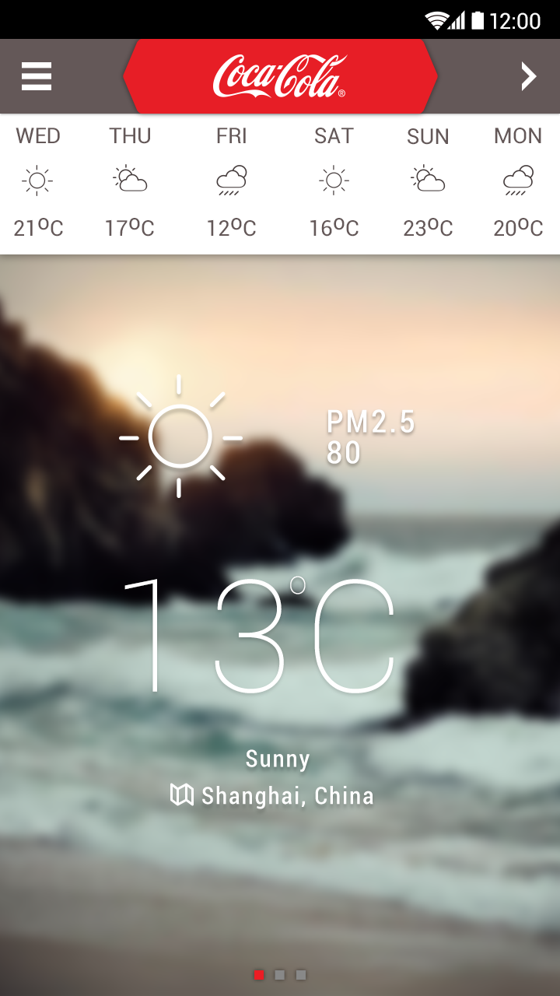
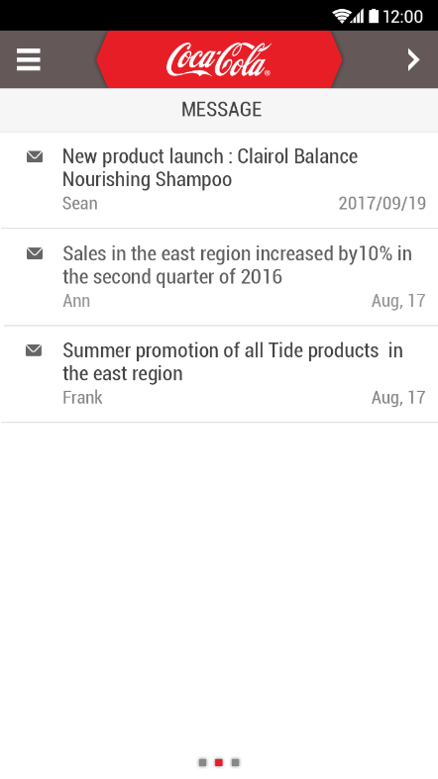
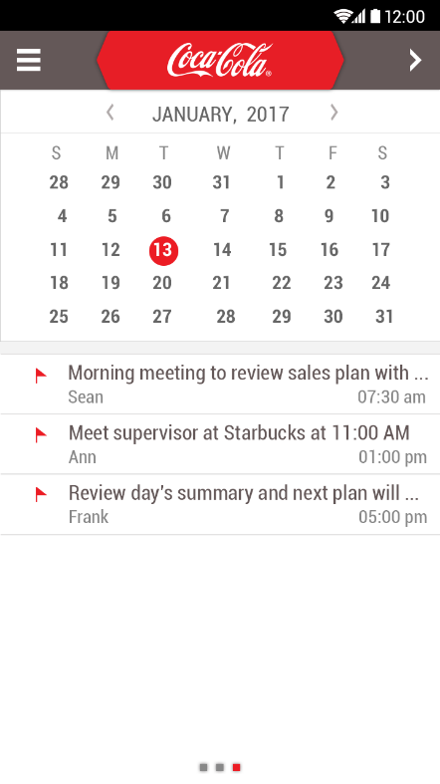
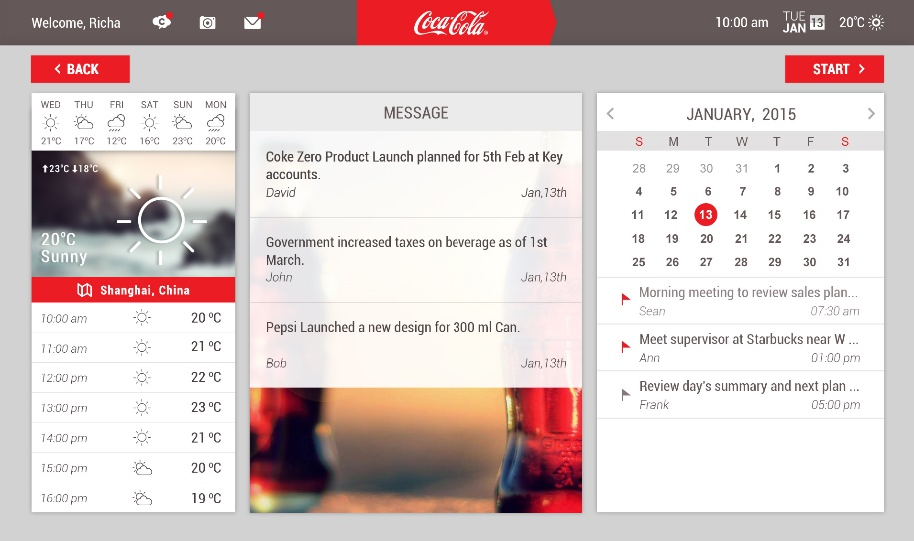
Screen Designs completed and in progress
5s Phone
Landing Screen
5s Tablet

Slide 4
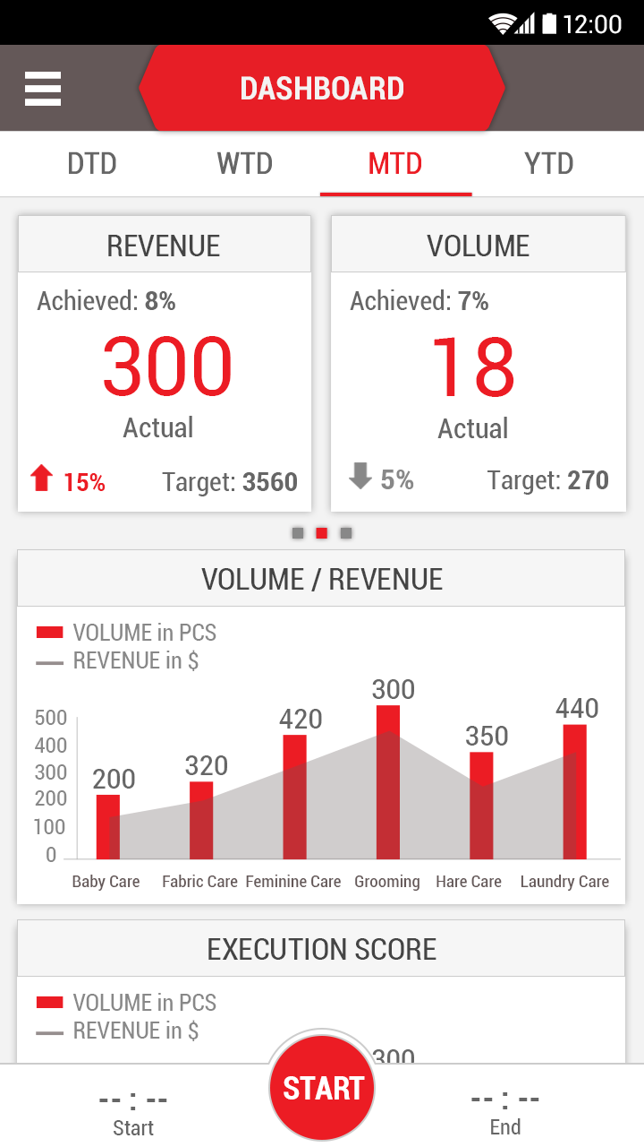


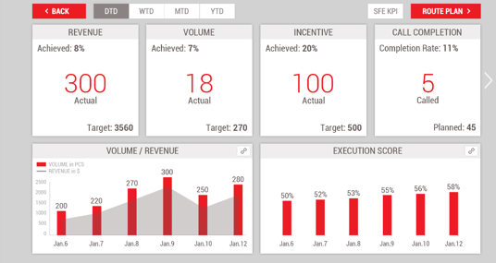
Screen Designs completed and in progress
5s Phone
Sales Rep Dashboard
5s Tablet
Notes:
Menu or back

Slide 5
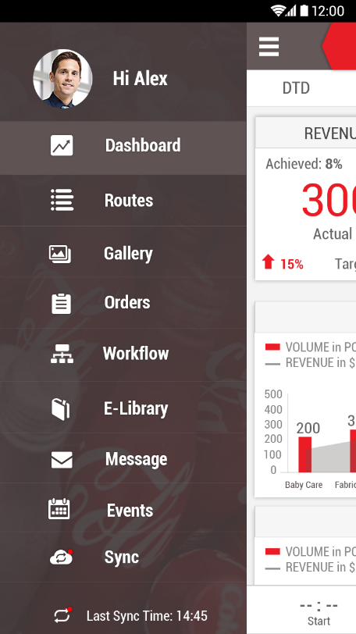
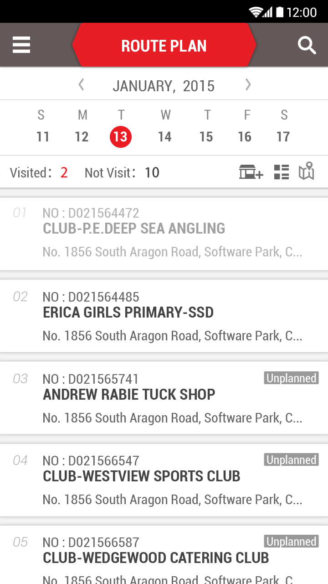
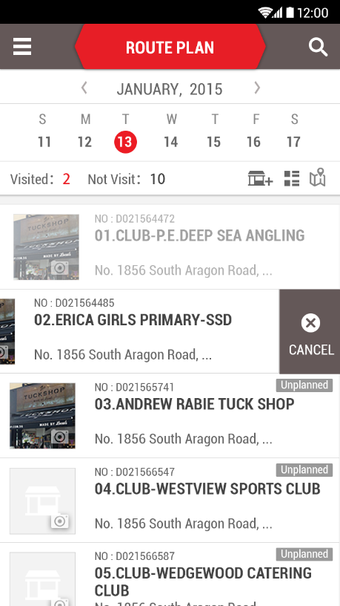
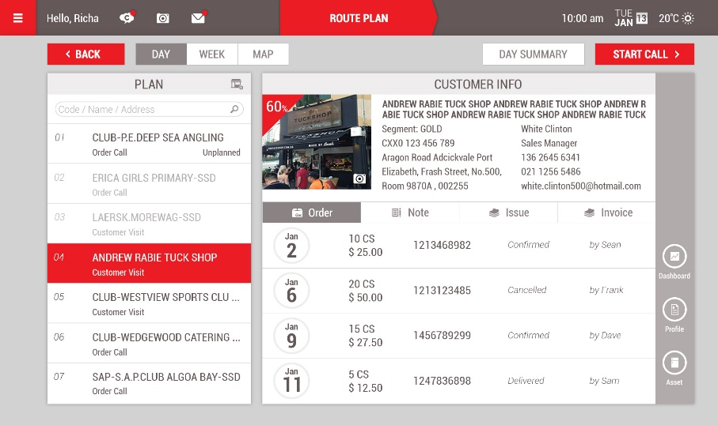
Screen Designs completed and in progress
5s Phone
5s Tablet
Route Plan

Slide 6
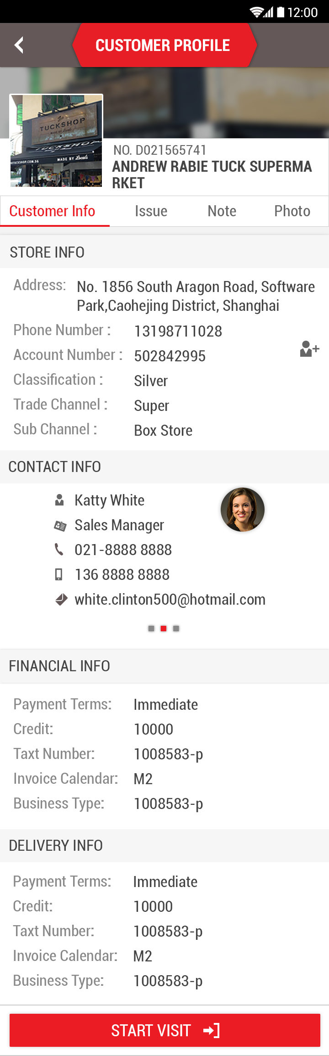
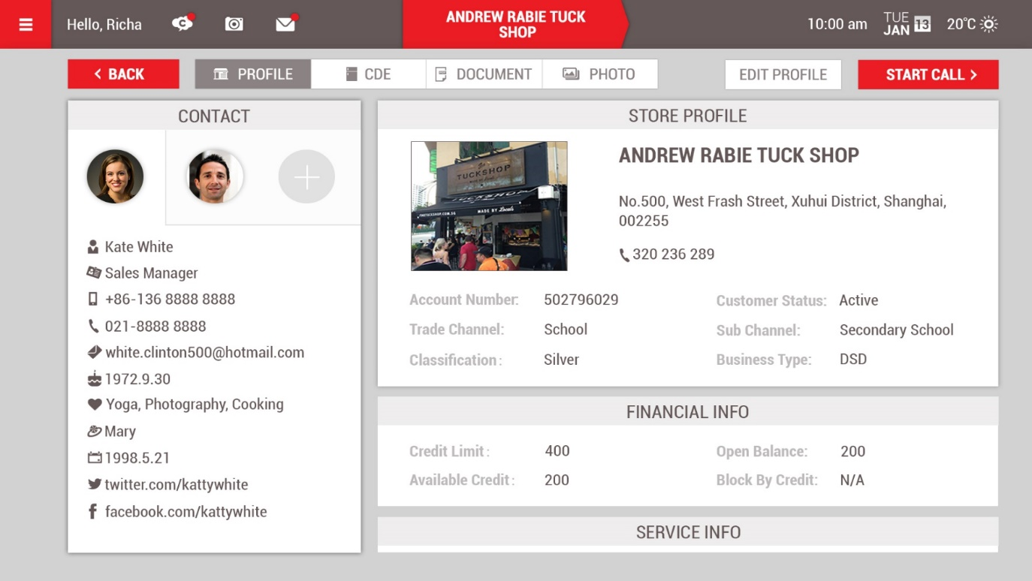
5s Phone
Customer Profile
5s Tablet

Slide 7
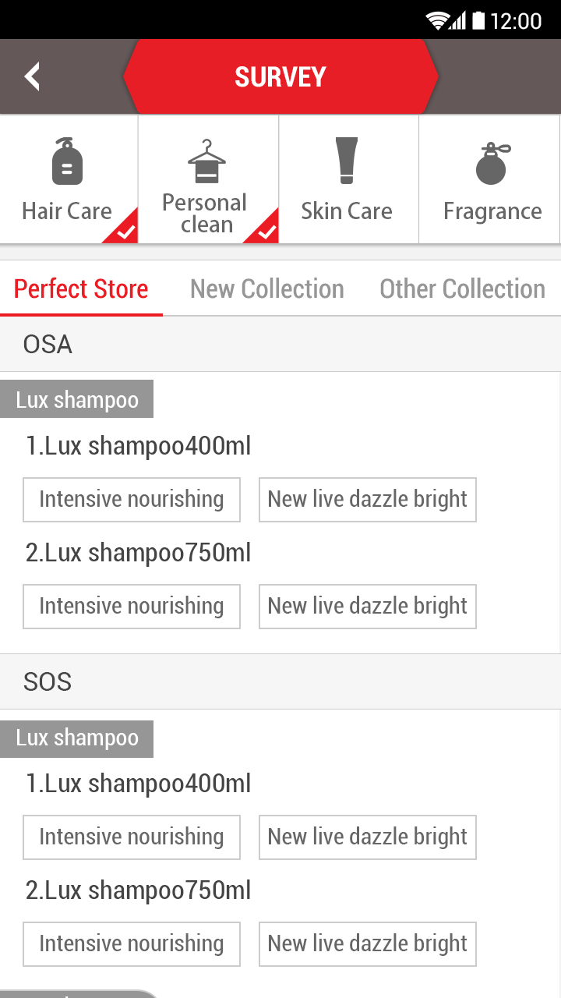
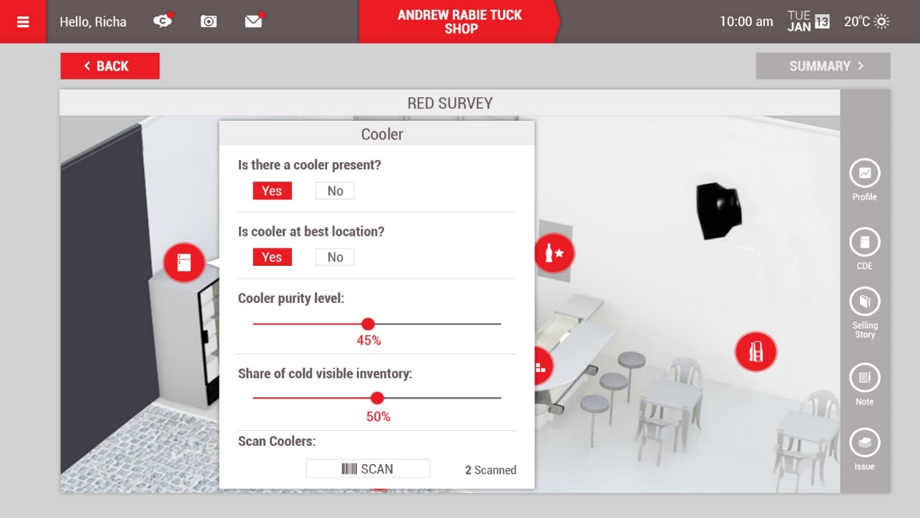
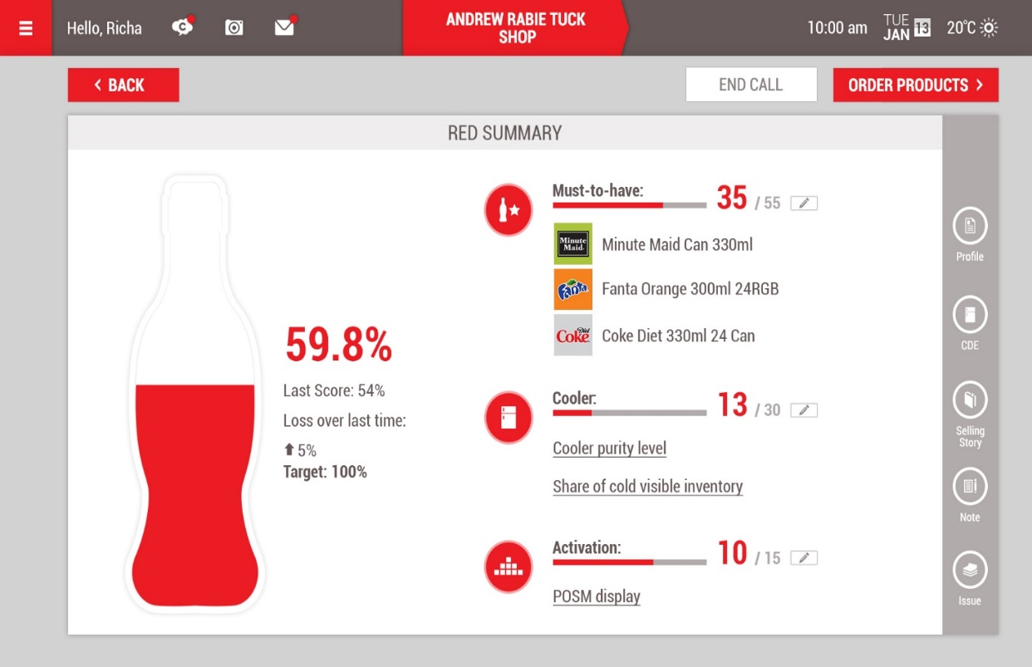
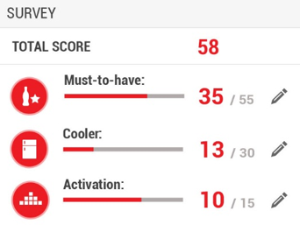
5s Phone
RED Survey
5s Tablet
Notes:
OSA =
SOS =
Survey => what is this used for ? can it be used to record SKU inventory status ?

Slide 8
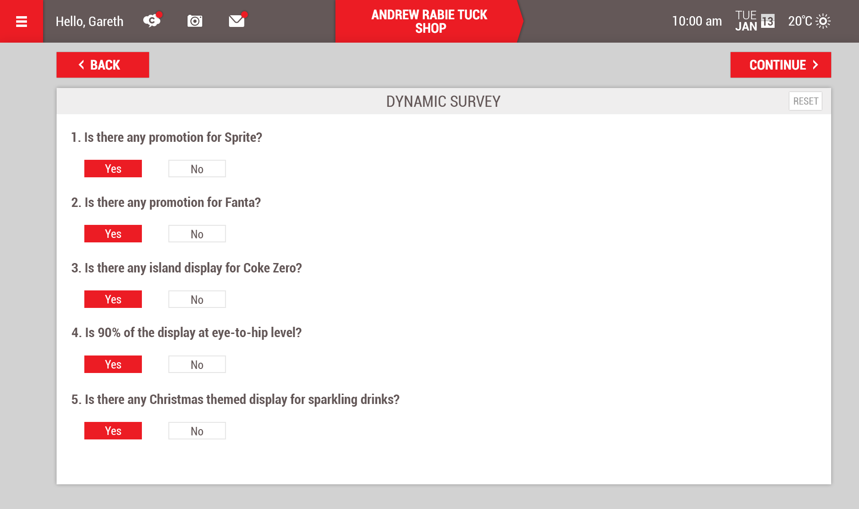
5s Phone
Dynamic Survey
5s Tablet

Slide 9
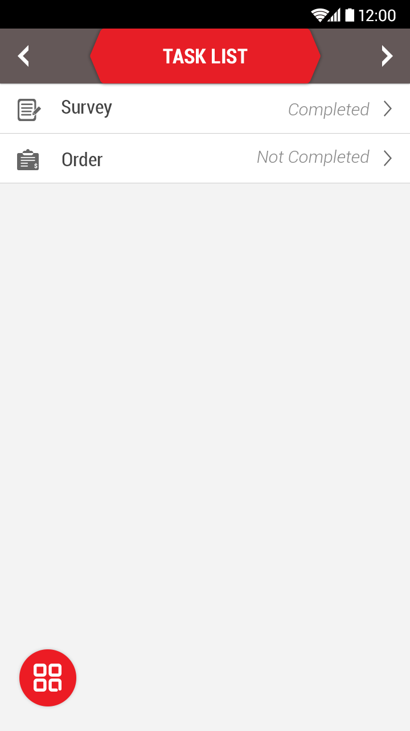
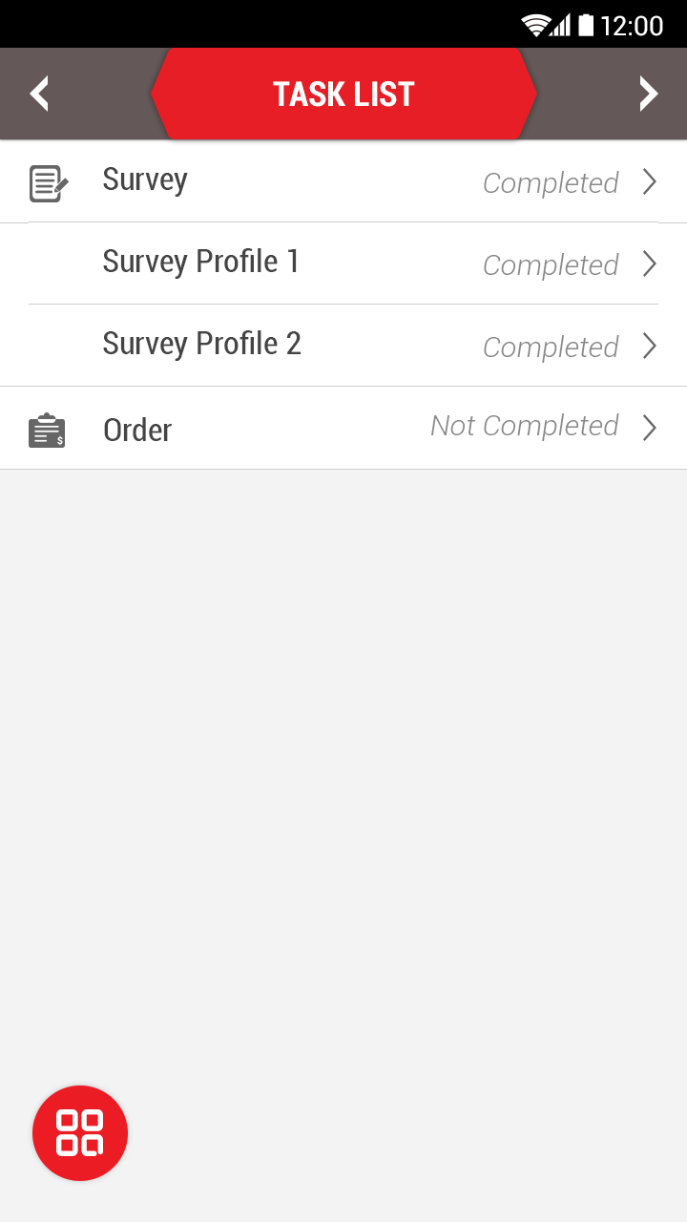
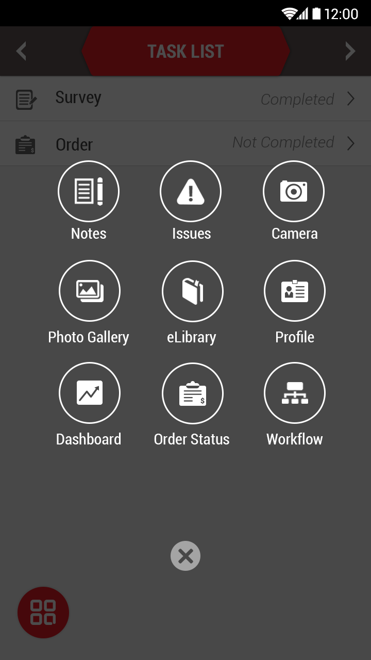
5s Phone
Visit Task List
5s Tablet
Not Required since on 5s the
visit is guided and follows
a sequence
Notes:
Visit Task List – this is not guided in the mobile app version?
SR can skip steps?

Slide 10
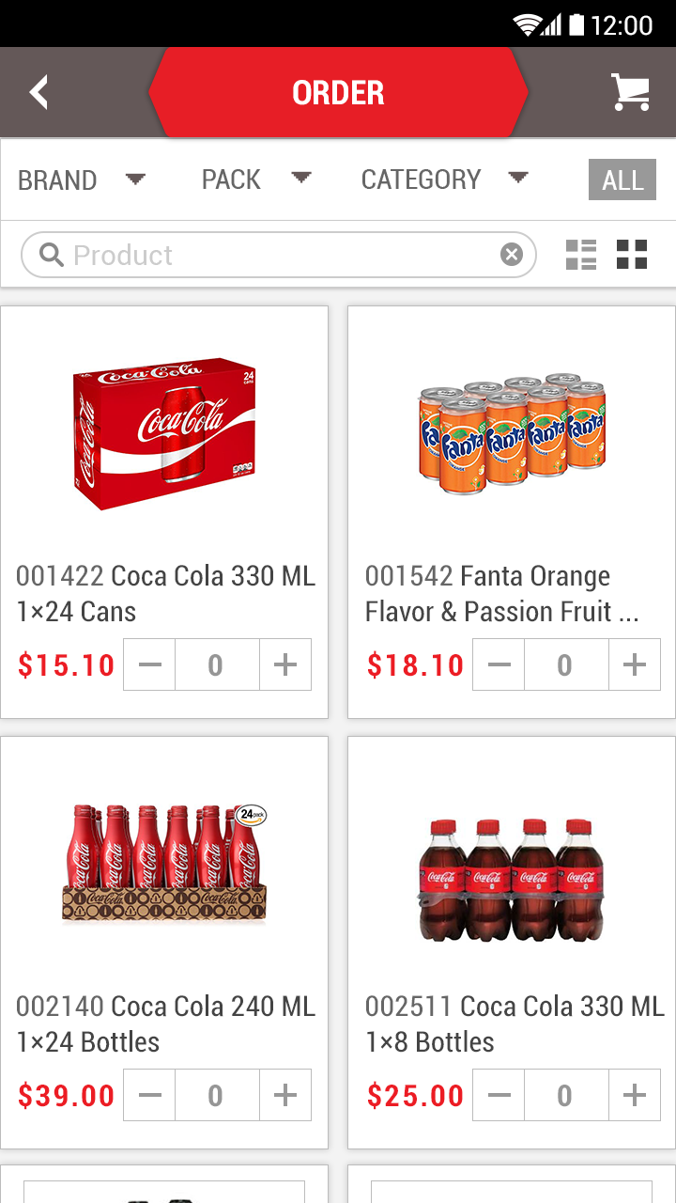
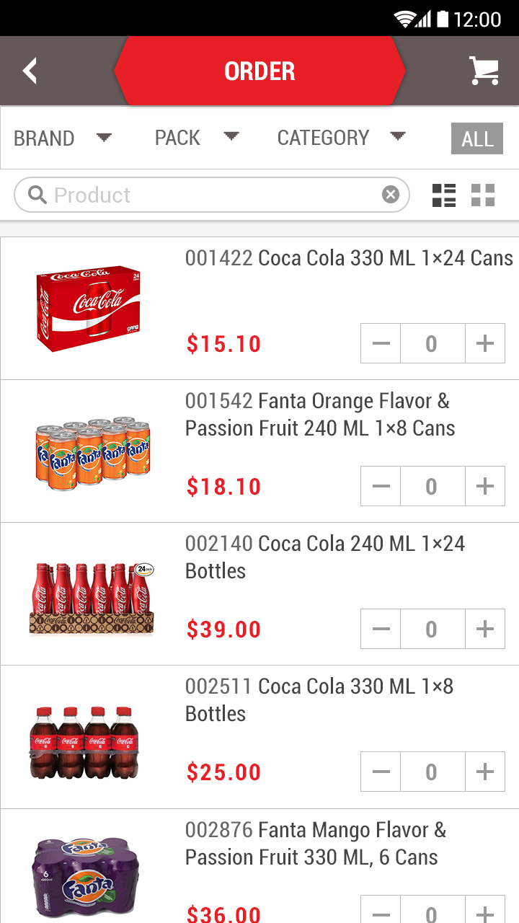
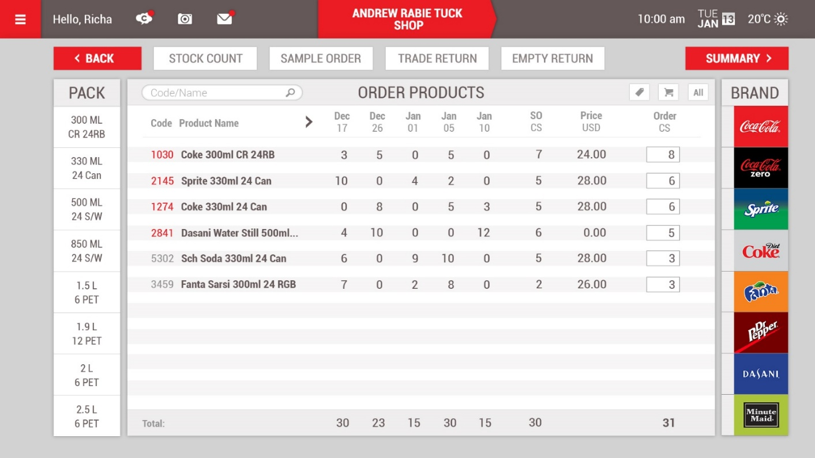
5s Phone
Order Taking
5s Tablet

Slide 11
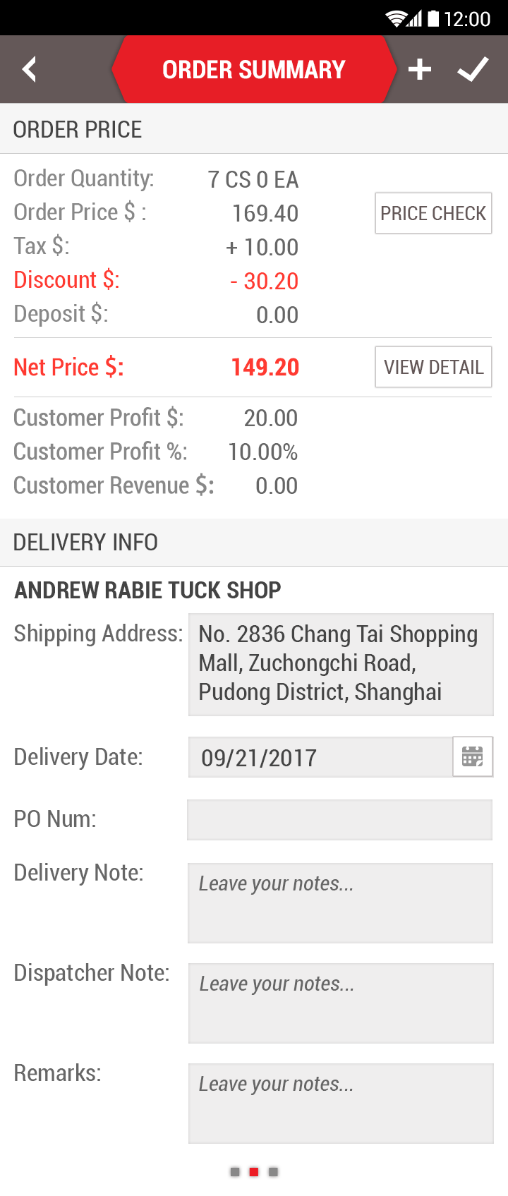
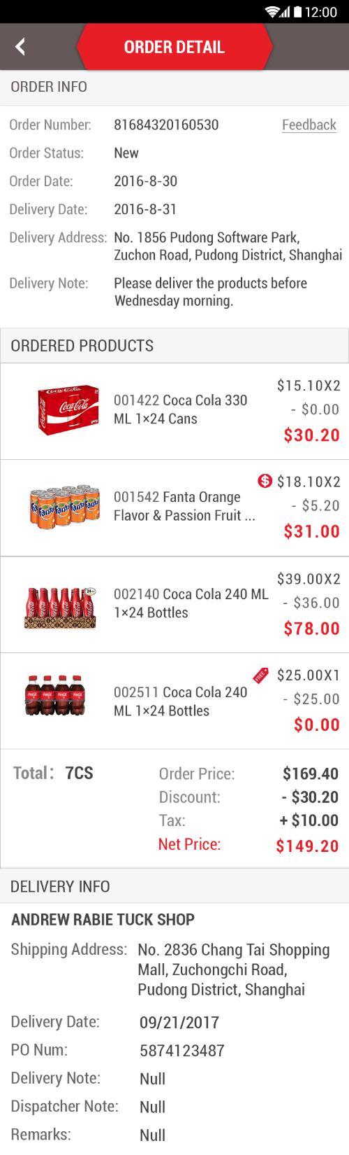
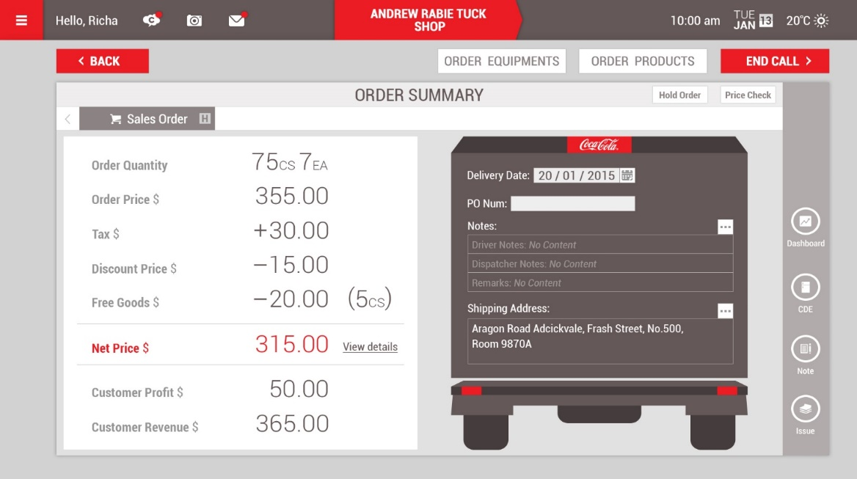
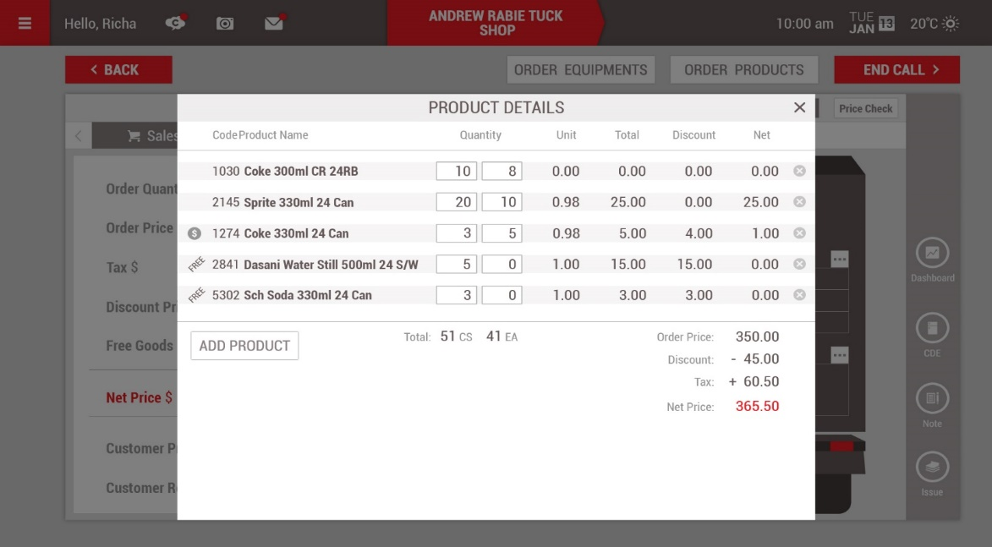
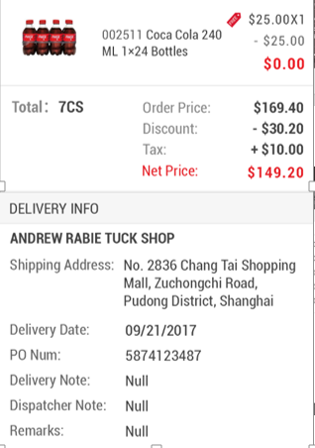
5s Phone
Order Summary
5s Tablet

Slide 12
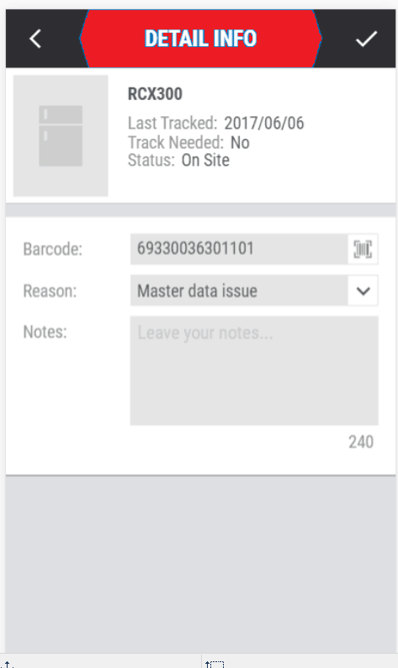
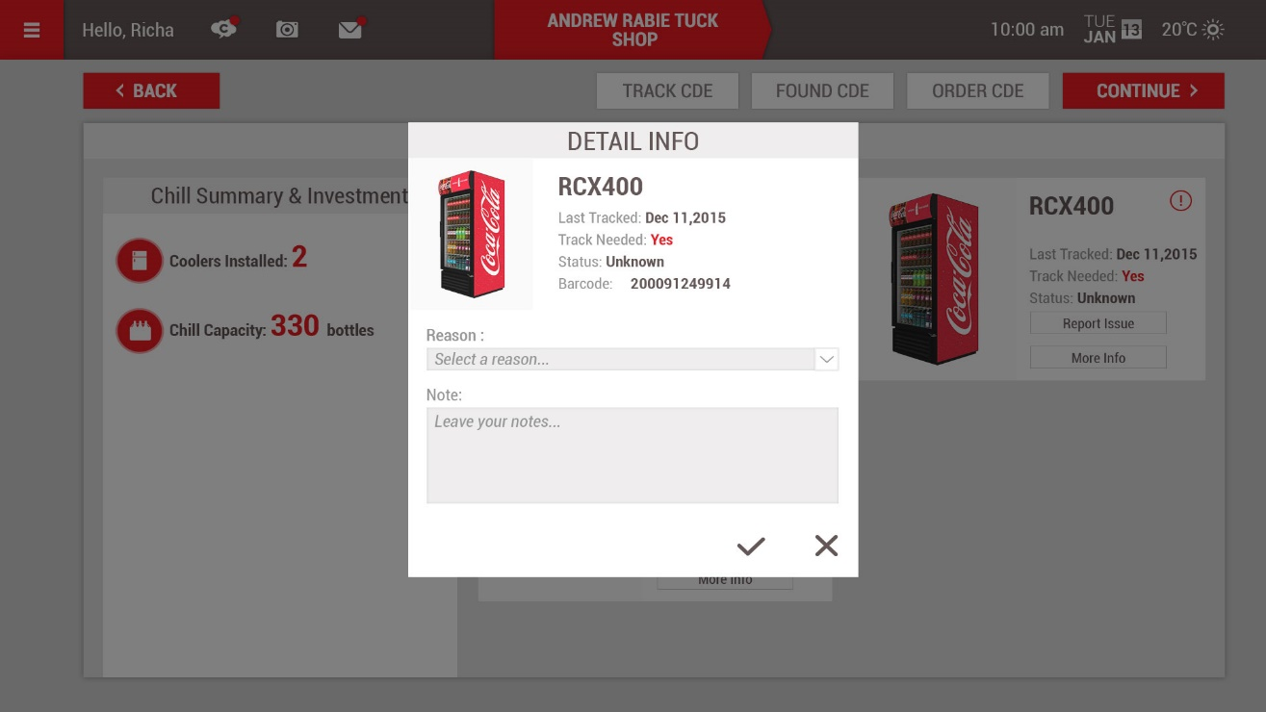
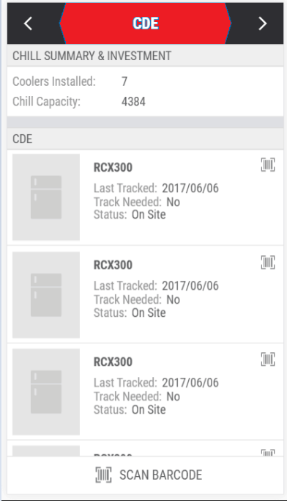
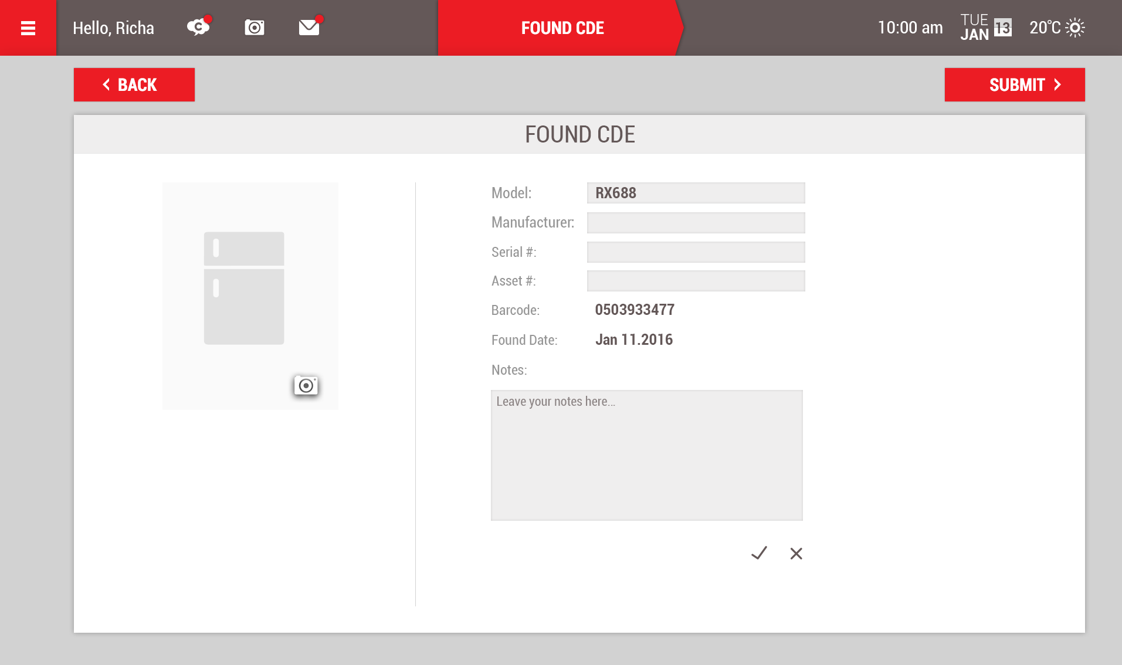
CDE Tracking
CDE Tracking
5s Phone
5s Tablet

Slide 13
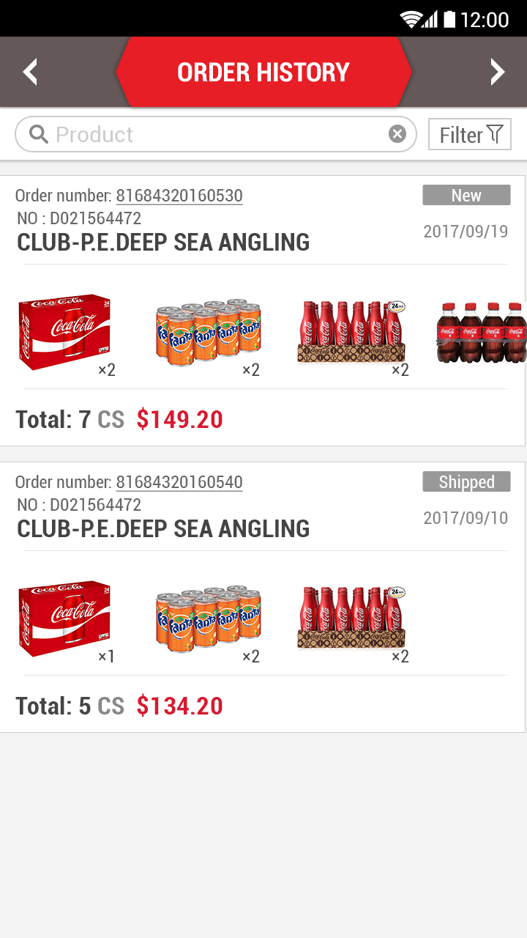
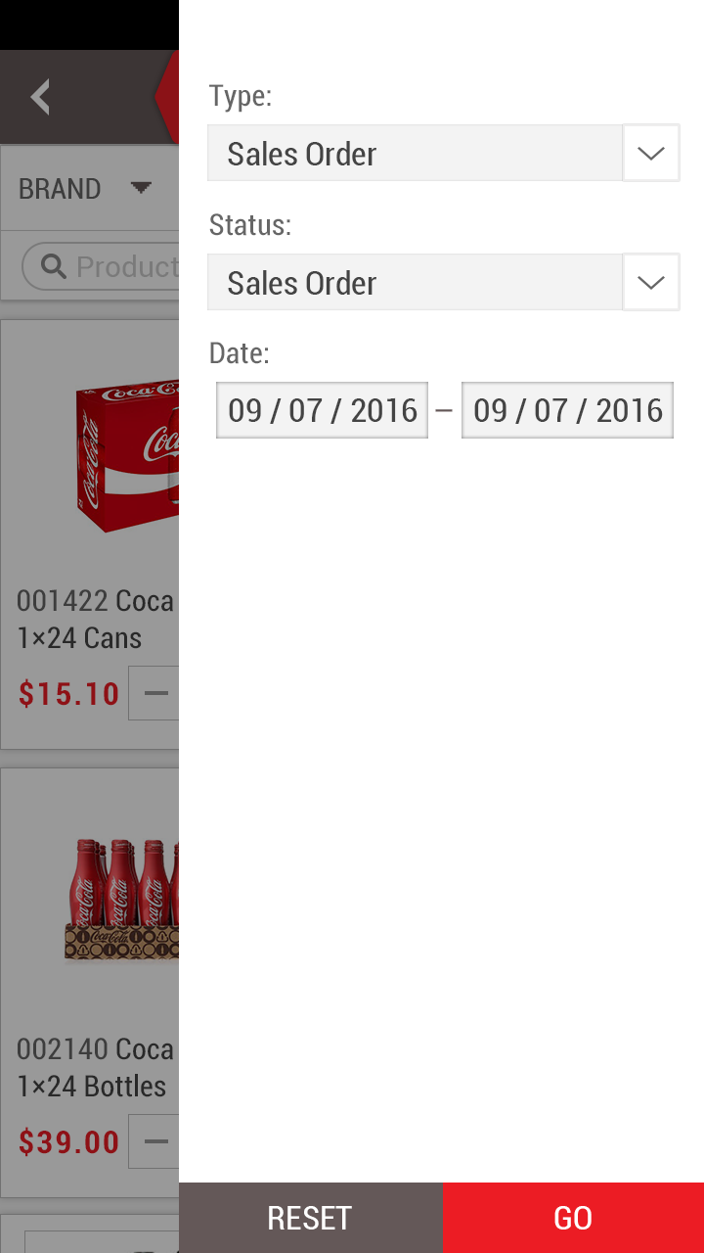
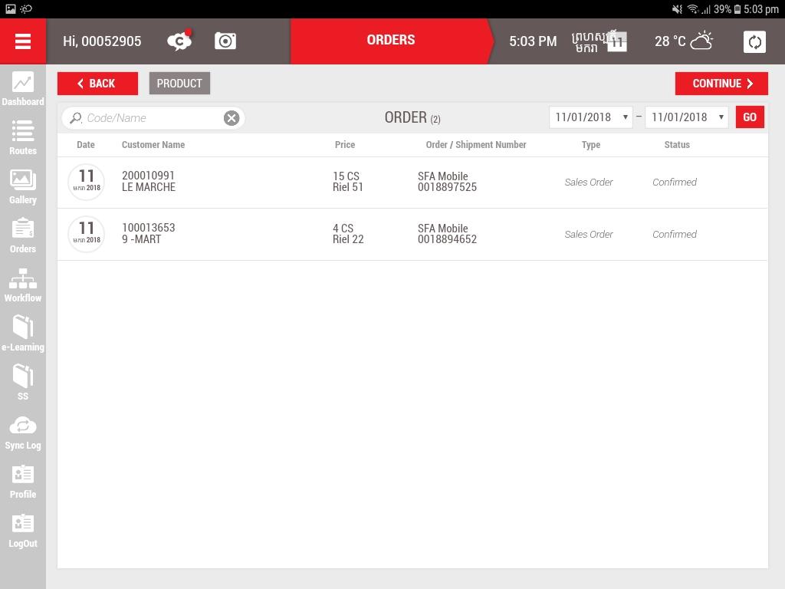
Order History
5s Phone
5s Tablet

Slide 14
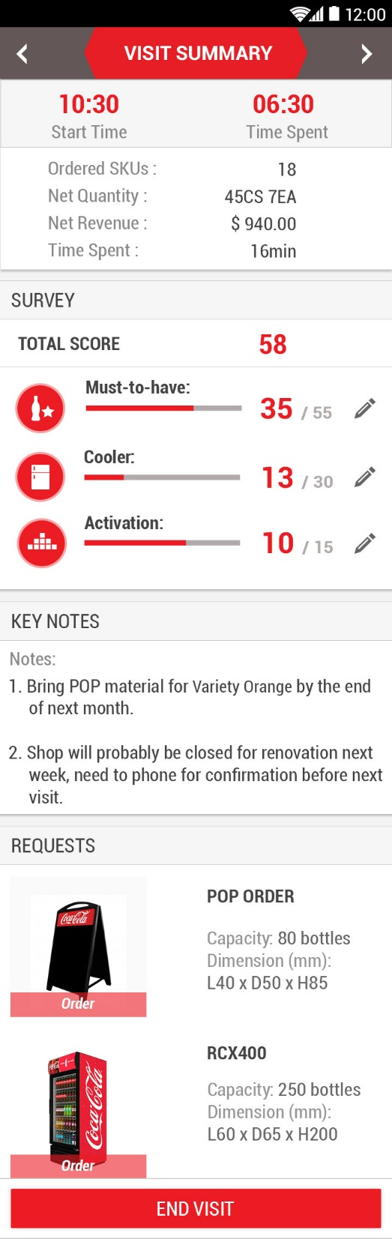
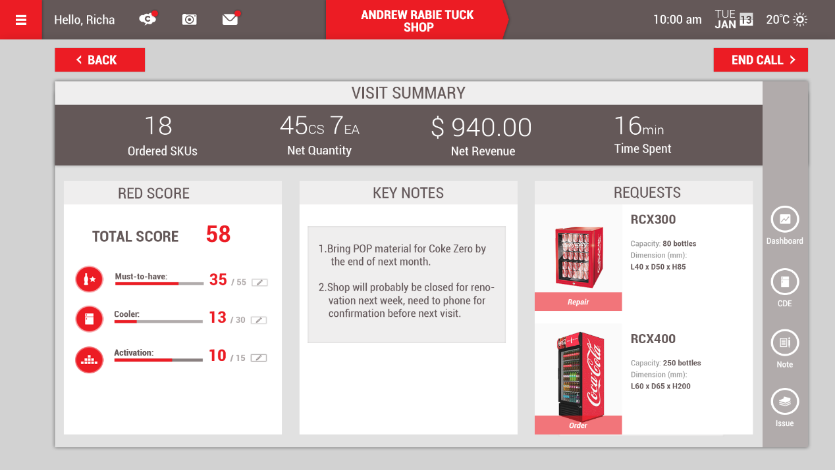
View detail
Visit Summary
5s Phone
5s Tablet

Slide 15
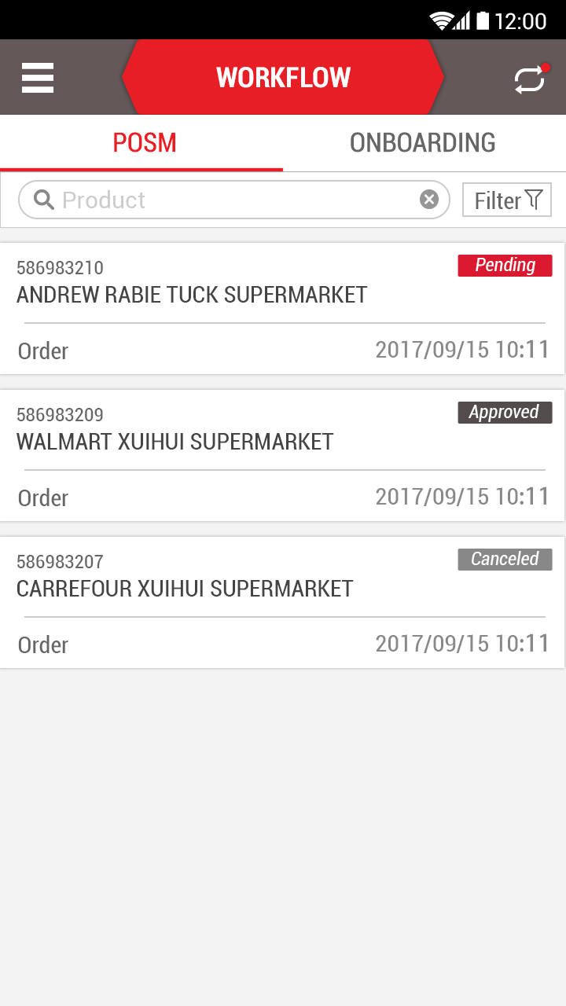
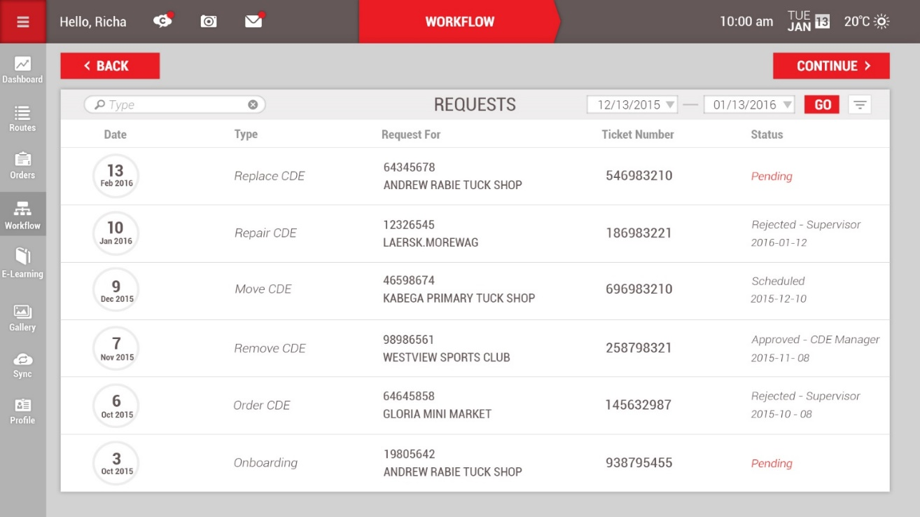
Workflows – Request Tracking
Workflows
5s Phone
5s Tablet

Slide 16
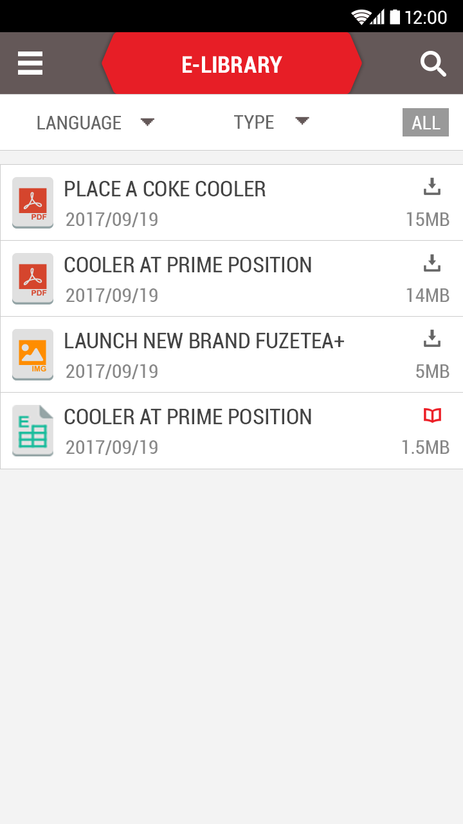
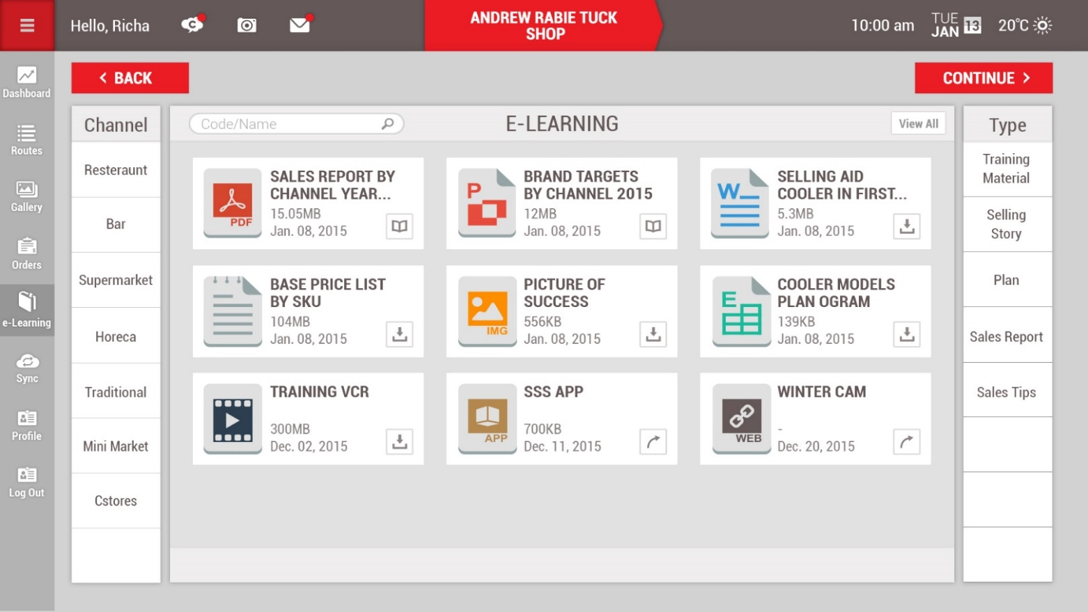
eLearning
E-Lib
5s Phone
5s Tablet

Slide 17
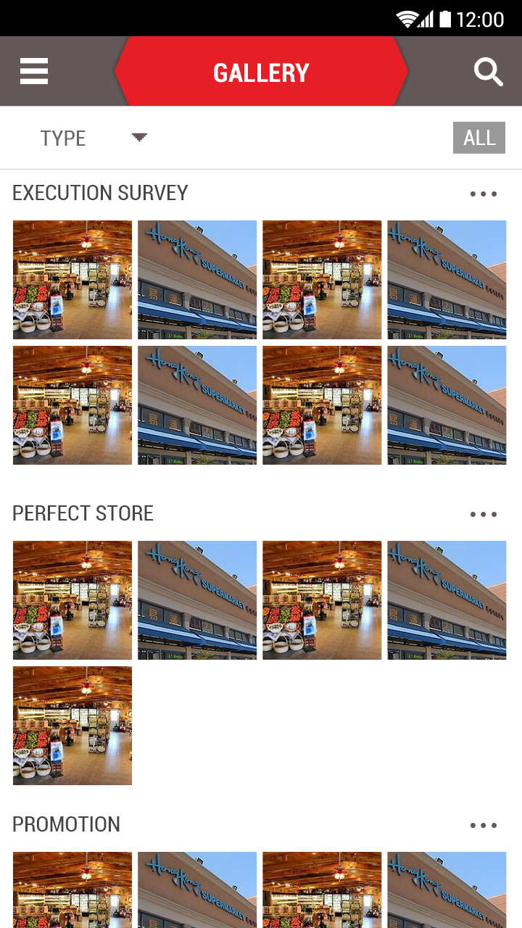
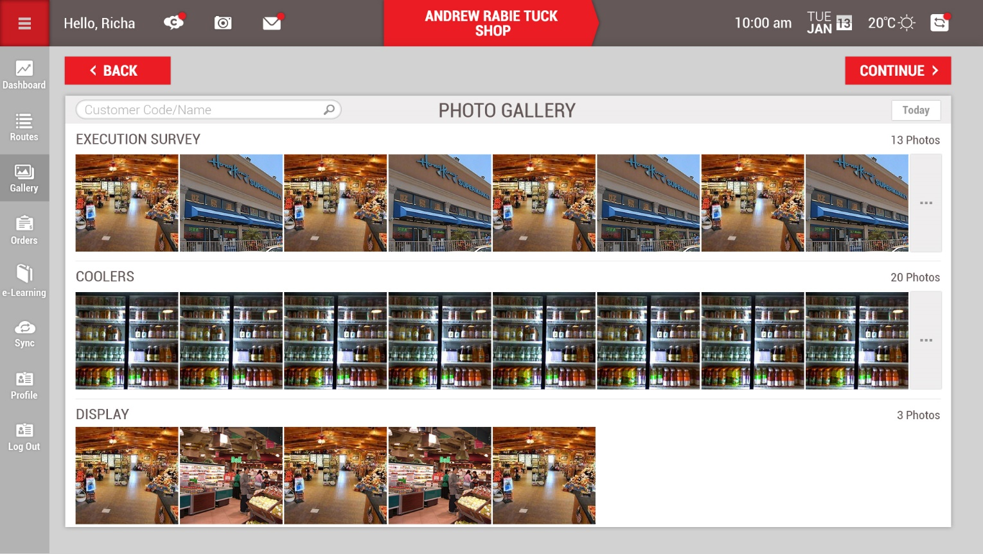
Photo Gallery
Photo Gallery
5s Phone
5s Tablet

Slide 18
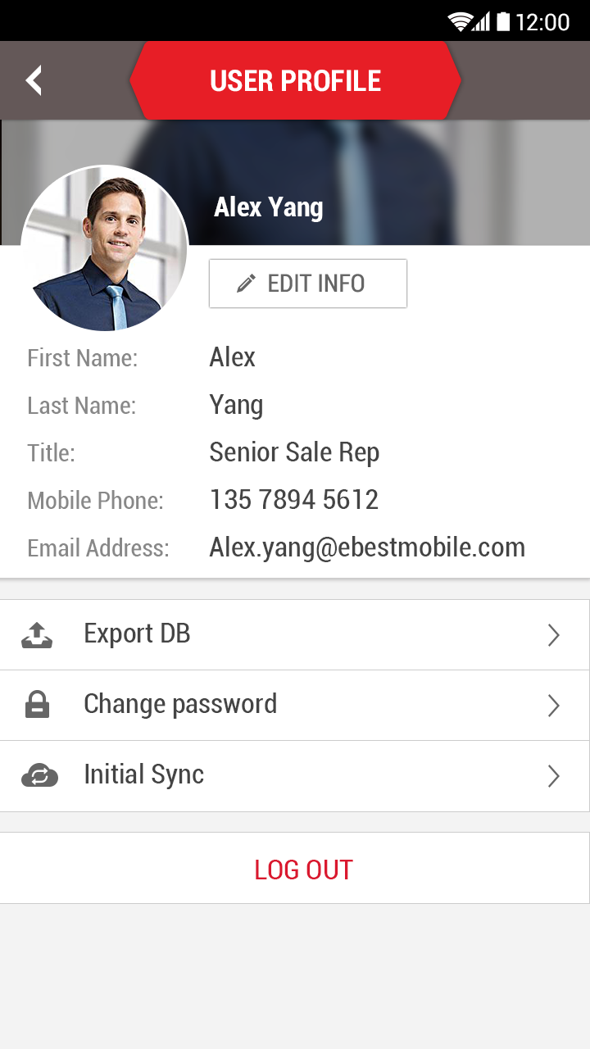
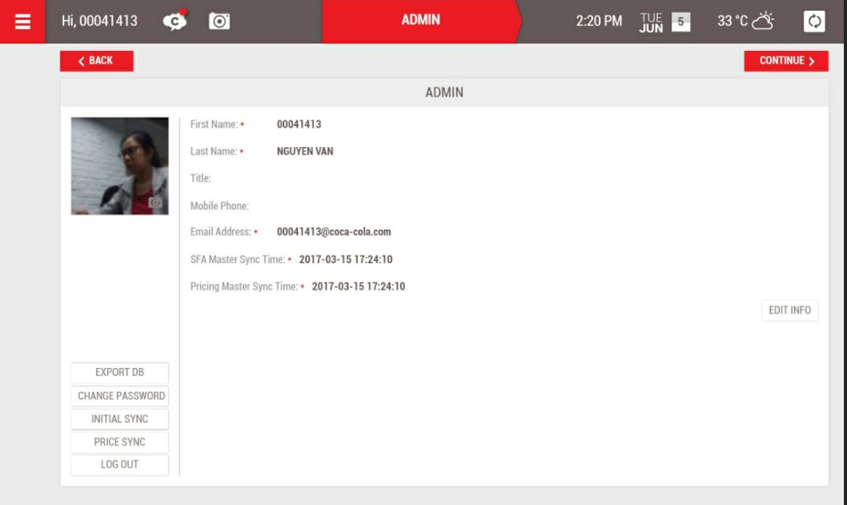
User Profile
5s Phone
5s Tablet

Slide 19
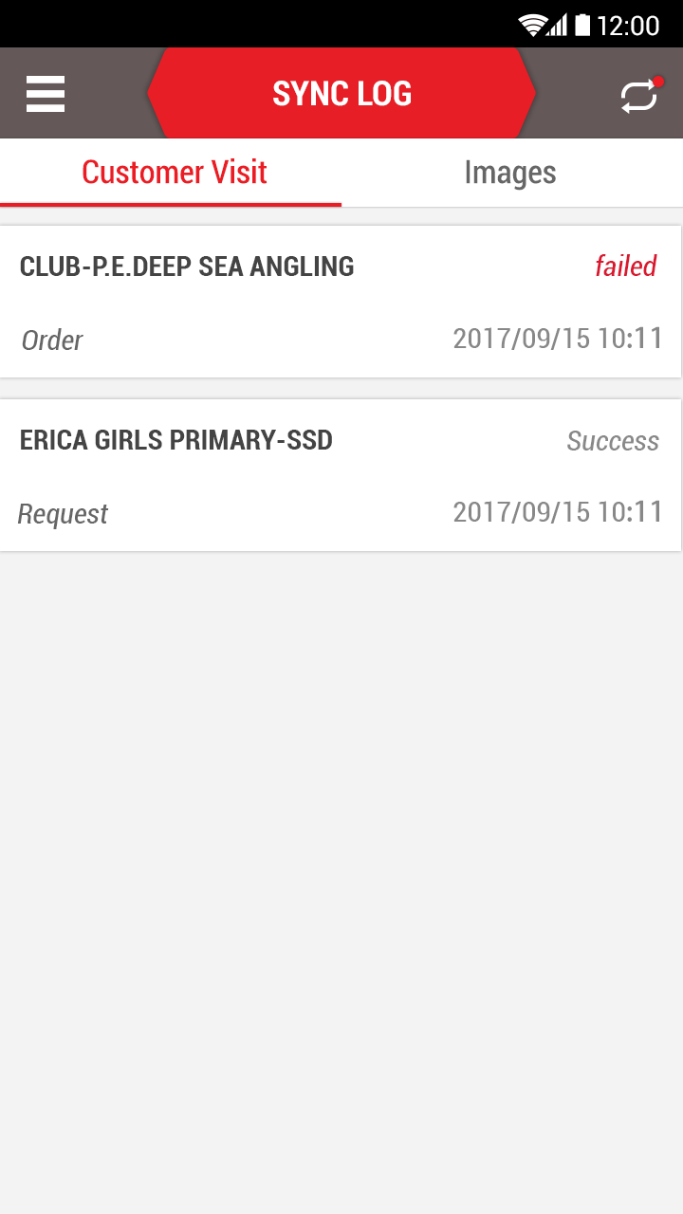
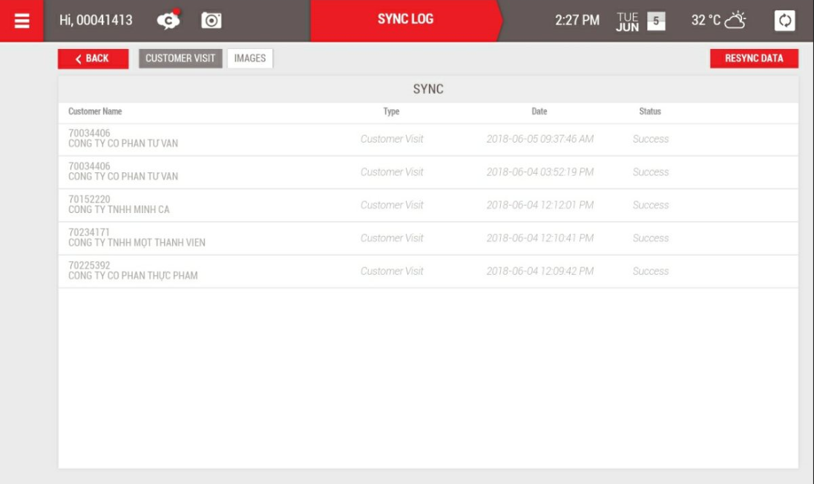
Sync Log
5s Phone
5s Tablet
Notes:
Promotion

Slide 20
Modules In Progress Timeline : Sep 2018

Slide 21
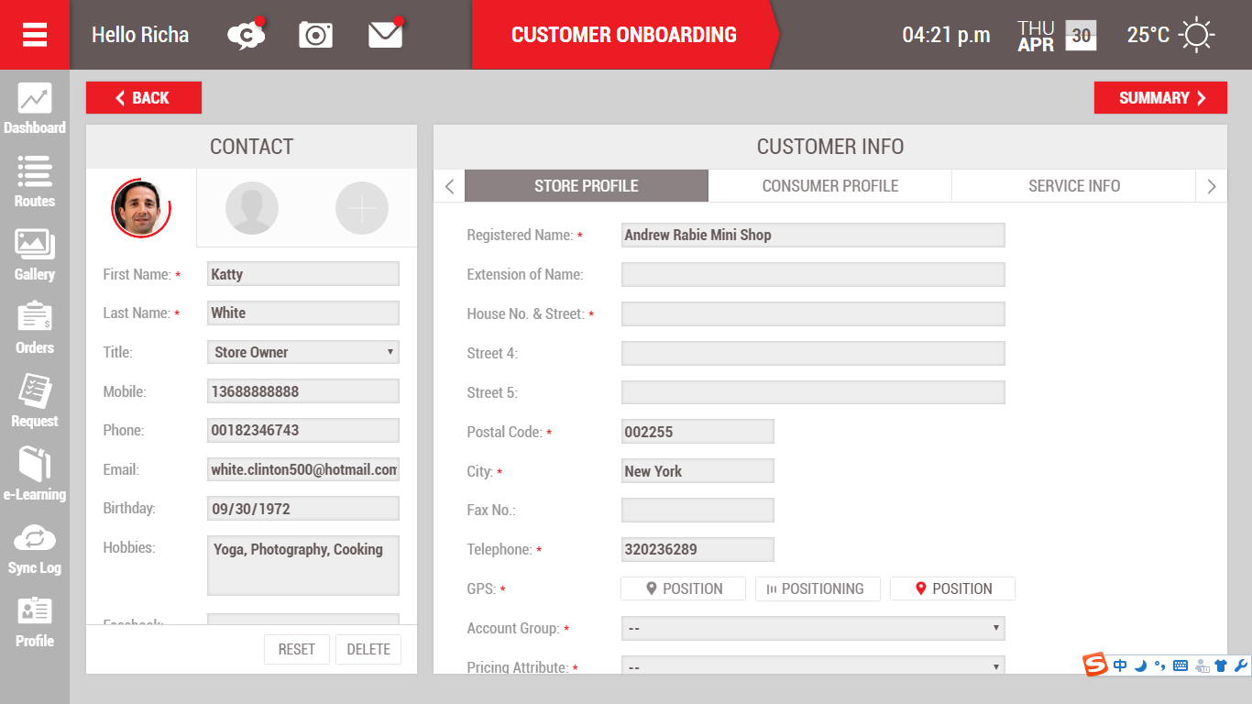

Customer Onboarding

Slide 22


CDE Order

Slide 23


CDE Maintenence

Slide 24


CDE Maintenance Summary

Slide 25


POP Orders & Tracking

Slide 26

Account AR warning

